Slide 1
Announcements
Cool things in the world of Angular
March, 2014
http://goo.gl/gtPuiR

Slide 2

7 AngularJS Releases!
AngularJS 1.2.9
Highlights:
162 PRs and issues closed!
New input types (date, time, etc.)
Animations for form validation states
DOM callbacks for animation
rAF instead of timeout for animation
Several performance enhancements
through
AngularJS 1.3.0-beta.1

Slide 3
5 AngularDart Releases!
AngularDart 0.9.5
Highlights:
279 PRs and issues closed!
Animation
Forms
Change detection @ 20k/millisecond
ngRepeat “track by”
Automatic digests via Zones
through
AngularDart 0.9.9

Slide 4
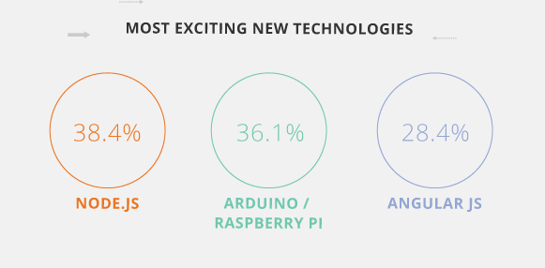
StackOverflow blog
StackOverflow blog

Slide 5
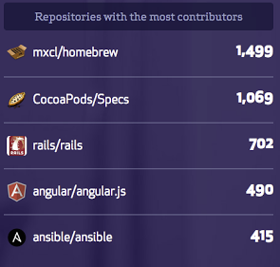
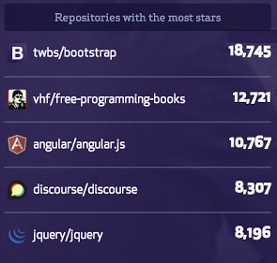
GitHub community

Slide 6
Call for meetup speakers!
goo.gl/i0o1S5

Slide 7
Thanks!
http://goo.gl/gtPuiR

